Slide 1
CS1231 Tutorial 10
AY18/19 – WEEK 12
Andrew Tan

Slide 2
Introduction to Graphs
Graphs – consists of a set of vertices and a set of edges
Directed graph – each edge is associated with an ordered pair of vertices

Slide 3
Definitions
Simple graph: undirected graph without loops or parallel edges
Complete graph: simple graph with one edge connecting each pair of distinct vertices
Complete bipartite graph: simple graph with two groups of vertices such that each vertex from one group has an edge with all the vertices in the other group

Slide 4
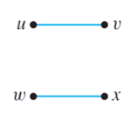
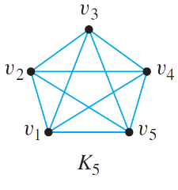
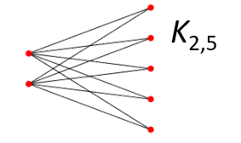
Definitions
Simple graph:
Complete graph:
Complete bipartite graph:

Slide 5
Trails, paths, and circuits
Walk from v to w – finite alternating sequence of adjacent vertices and edges of a graph G. Start at v, end at w.
Trail – walk with no repeated edges
Path – trail with no repeated vertices
Closed walk – start and end at same vertex
Circuit/Cycle – closed walk with at least one edge and no repeated edges
Simple cycle – cycle with no repeated vertices except the first/last

Slide 6
Connectedness
Two vertices are connected iff there is a walk from one to the other.
A graph is connected if any two vertices in the graph are connected.

Slide 7
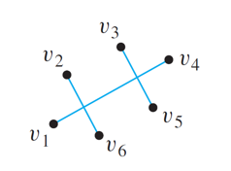
Connected Components
A connected component of a graph is a connected subgraph of the largest possible size.
We can think of any given graph as a union of its connected components.
e.g. Number of CCs = 3

Slide 8
Euler circuits
Euler circuit – a circuit that passes through every vertex at least once, and uses every edge exactly once
For a graph to have an Euler circuit, every vertex of the graph must have positive even degree and is connected.
Euler trail – a trail from v to w that passes through every vertex at least once, and traverses every edge exactly once

Slide 9
Hamiltonian circuits
Hamiltonian circuit – passes through every vertex of G exactly once.
Travelling salesman problem – minimize distance while travelling to all cities

Slide 10
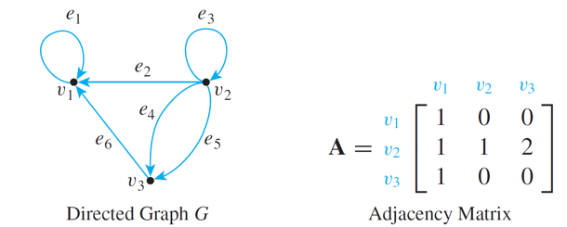
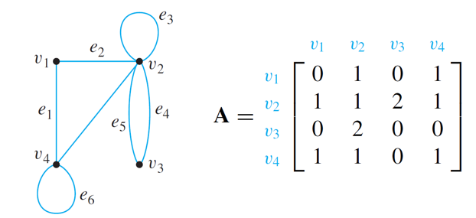
Adjacency matrix representations
Entries in the matrix represent number of edges between vertices
Directed graph Undirected graph

Slide 11
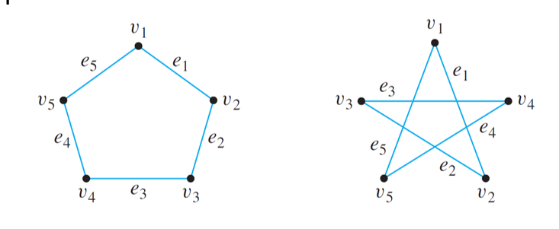
Isomorphisms of graphs
Two graphs that are the same except for the labelling of their vertices and edges are called isomorphic

Slide 12
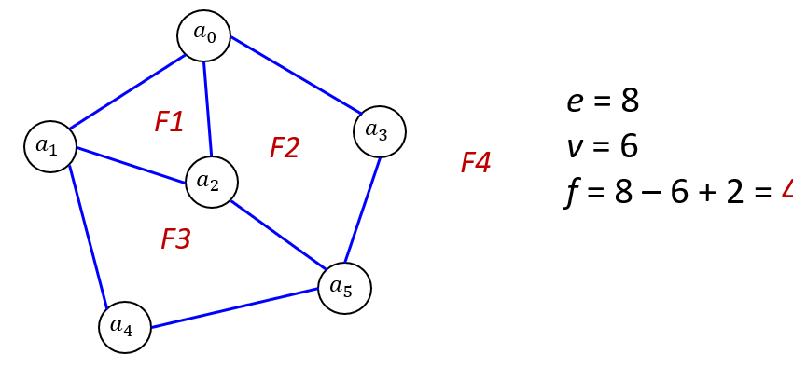
Planar graph
A planar graph is a graph that can be drawn on a 2D plane without edges crossing
Euler’s formula – for a connected planar simple graph,
|faces| = |edges| - |vertices| + 2

